Slide 1
Vīta Marthae Marchinae
Dictatio

Slide 2
Directions
The sentence will be read three times. Record it to the best of your ability. After the third time, the full sentence will be shown.
Make corrections on the line below your recording. You do not have to rewrite the entire sentence, but rewrite the entire word that was incorrect. Use two different colored pens/pencils if you can. Also correct errors in macrons.
Meaning will be discussed after the sentence is revealed.
As long as you (1) put your name on it and (2) follow these directions, you will get full credit regardless of how many errors you make.

Slide 3
Prīma Sententia
Martha Marchīna erat Catholica vātes quae in Ītaliā nāta est.

Slide 4
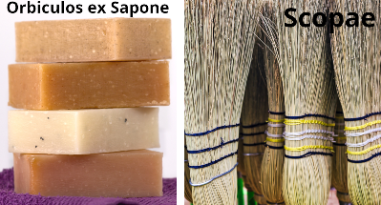
Secunda Sententia
Pater Marchīnae orbiculōs ex sāpōne odōrātō et scōpās vendēbat.

Slide 5
Tertia Sententia
Māter Marchīnae mortua est cum Marchīna septem annōs nāta est.

Slide 6
Quārta Sententia
Itaque Marchīna cūrābat frātrēs quia in familiā nōn iam māter erat.

Slide 7
Quīnta Sententia
Marchīna magistra optima vidēbātur frātribus et patrī.

Slide 8
Sexta Sententia
Marchīna plūrēs librōs Latīnōs legere volēbat.

Slide 9
Septima Sententia
Marchīna, autem, emere librōs non poterat.

Slide 10
Octāva Sententia
Pater Santolīnus in templō multōs librōs habuit.

Slide 11
Nōna Sententia
Pater Santolīnus, autem, dīxit “legere nōn licet!”

Slide 12
Decima Sententia
Marchīna librōs legere per sex annōs nōn poterat.

Slide 13
...et? Quomodo Marchīna illōs librōs lēgit? Cūr tandem librōs Latīnōs legere Marchīnae licuit? Quid putātis? Scrībite saltem trēs sententiās.

