Slide 1
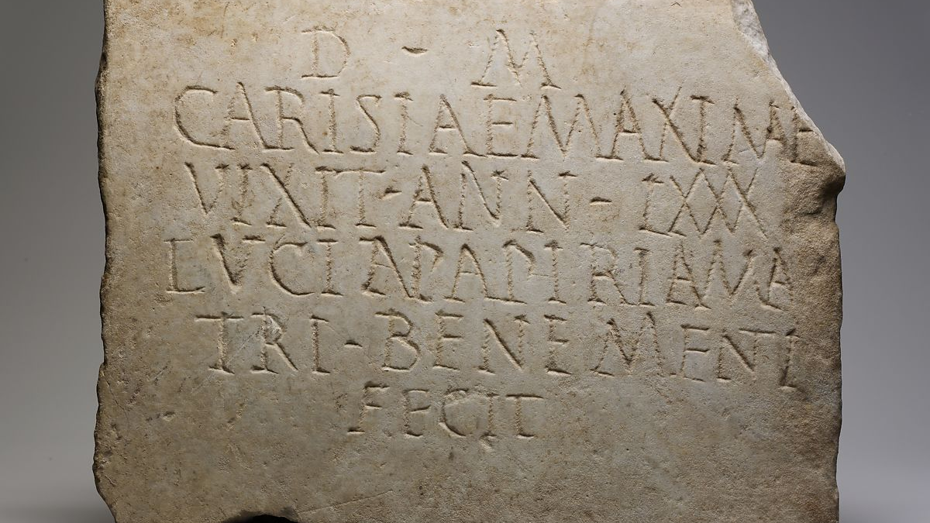
Gementem, Plangentem, Plorantem
Funerary Inscriptions
Notes:
https://www.metmuseum.org/art/collection/search/256774

Slide 2
V. Salvidiena Q. L. Hilara Salvidienae Faustillae deliciae suae eruditae omnibus artibus. Reliquisti mammam tuam gementem plangentem plorantem. Vix(it) an. XV mensib. III dieb. XI hor. VII. Virginem eripuit Fatus malus. Destituisti, Vitilla mea, miseram mammam tuam.

Slide 3
V. Salvidiena Q. L. Hilara
V. could refer to viva, to emphasize that unlike the deceased, she is alive
V. could also be a name
Q.L. stands for Libertina Quinti
She is Quintus’ freed slave
Enslaved people were never entirely separated from their former enslavers. Even in a funeral monument to her daughter, she identifies herself as a former slave and who had enslaved her.

Slide 4
V. Salvidiena Q. L. Hilara Salvidienae Faustillae
Who is Salividiena Hilara addressing in this monument?

Slide 5
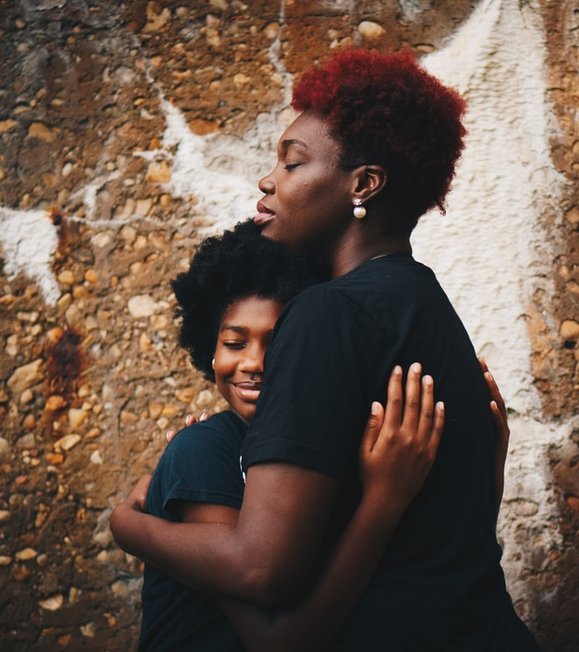
V. Salvidiena Q. L. Hilara Salvidienae Faustillae deliciae suae
Notes:
https://unsplash.com/photos/zQQ6Y5_RtHE

Slide 6
V. Salvidiena Q. L. Hilara Salvidienae Faustillae deliciae suae eruditae omnibus artibus.
Quomodo erudite erat?
Quae sunt omnes artes?

Slide 7
Reliquisti mammam tuam
Mamma = Mater
Notes:
https://unsplash.com/photos/Wr3HGvx_RSM

Slide 8
Reliquisti mammam tuam gementem plangentem plorantem.

Slide 9
Vix(it) an. XV mensib. III dieb. XI hor. VII.
Notes:
https://unsplash.com/photos/FlHdnPO6dlw

Slide 10
Virginem eripuit Fatus malus.

Slide 11
Destituisti, Vitilla mea, miseram mammam tuam.
Notes:
https://unsplash.com/photos/7KHCNCddn2U

Slide 12
V. Salvidiena Q. L. Hilara Salvidienae Faustillae deliciae suae eruditae omnibus artibus. Reliquisti mammam tuam gementem plangentem plorantem. Vix(it) an. XV mensib. III dieb. XI hor. VII. Virginem eripuit Fatus malus. Destituisti, Vitilla mea, miseram mammam tuam.

