Slide 1
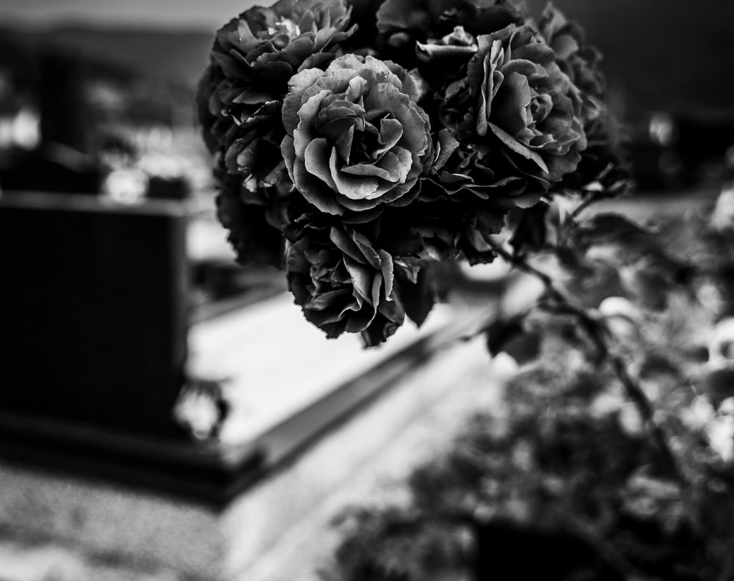
Tumulus
Magdalenae Marchinae Sororis
Notes:
https://unsplash.com/photos/Pb3opN-1Yao

Slide 2
Directions
Use your whiteboard to write in suggested answers to the blanks.
Be creative, but also remember the tone and context of this poem.

Slide 3
Magdālis, Virtūtis imāgō, hōc tumulō ____________.

Slide 4
Magdālis, Virtūtis imāgō, hōc tumulō tegitur.

Slide 5
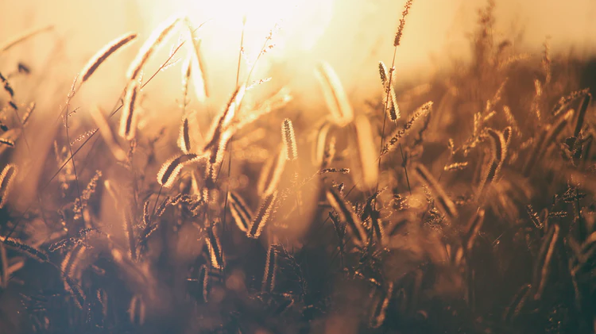
__________ erat Magdalenae nōndum septima messis.
Notes:
https://unsplash.com/photos/uQN9KaPTeI4

Slide 6
Addita erat Magdalenae nōndum septima messis.
Notes:
https://unsplash.com/photos/uQN9KaPTeI4

Slide 7
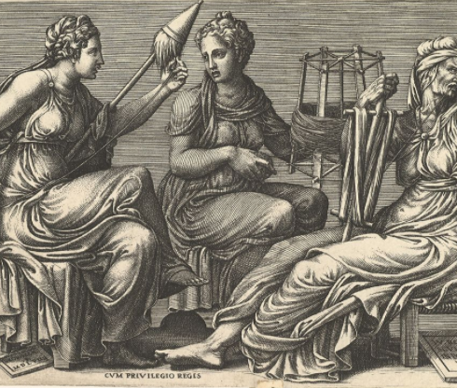
Sed vix Parca impia ēripuit _______________,
Notes:
https://www.metmuseum.org/art/collection/search/367537

Slide 8
Sed vix Parca impia ēripuit aspectam lūcem,
Notes:
https://www.metmuseum.org/art/collection/search/367537

Slide 9
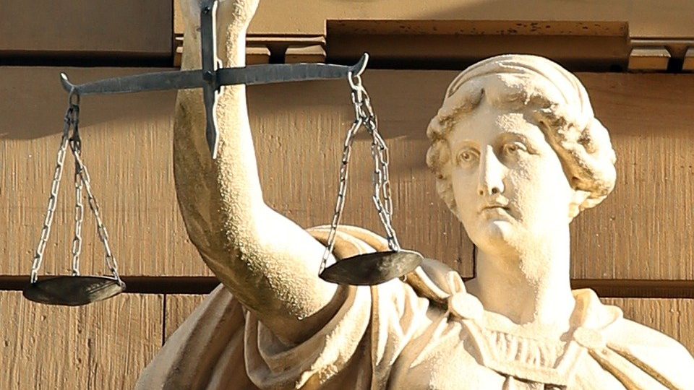
____________, & __________, dum putat esse parēs.
Notes:
https://pixabay.com/photos/justitia-zodiac-sign-421805/

Slide 10
Aetātem, & laudēs, dum putat esse parēs.
Notes:
https://pixabay.com/photos/justitia-zodiac-sign-421805/

Slide 11
Tumulus Magdalenae Marchīnae Sorōris
Magdālis hōc tumulō tegitur, Virtūtis imāgō,
Addita cui nōndum septima messis erat.
At vix aspectam ēripuit Parca impia lūcem,
Aetātem, & laudēs, dum putat esse parēs.

Slide 12
Cūr Parca impia erat?

Slide 13
Quomodo Marchīna dēscrīpsit sorōrem suam?

Slide 14
Si sorōrem habēs, quomodo eam dēscrībis?

Slide 15
Amābat Marchīna sorōrem suam? Cūr?

Slide 16
Nōs aetātem messibus nōn iam dēscrībimus. Quomodo hodiē dēscrīberēmus aetātem? (Nōn licet utī annīs).

